Slide 1
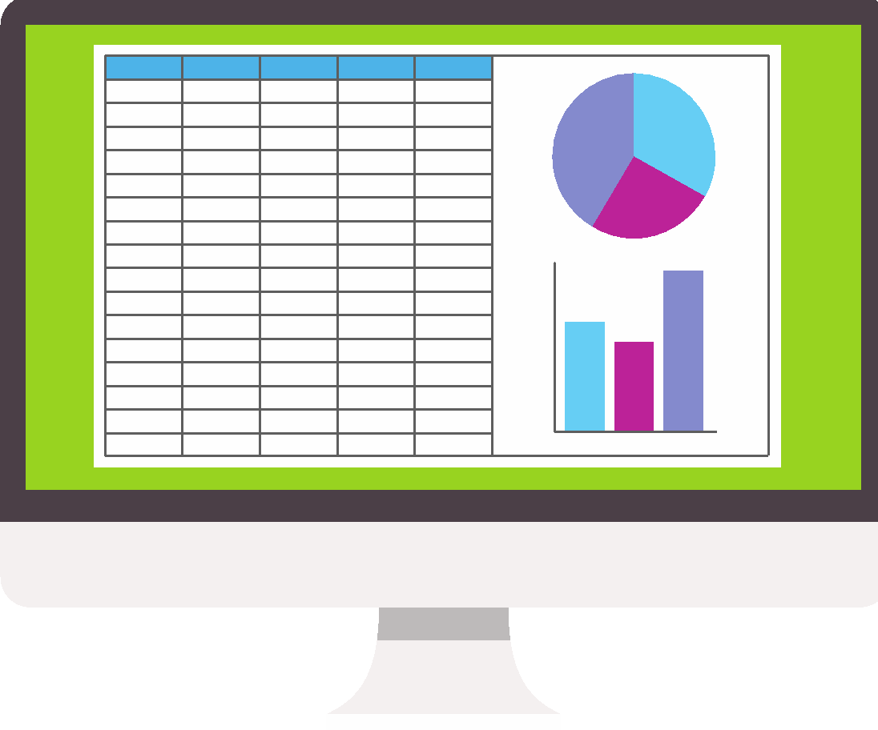
Introducing spreadsheets
Lesson 5: Modelling

Slide 2
Objectives
In this lesson you will learn:
how spreadsheets are used to model different situations
to develop a spreadsheet so that different scenarios can be tested
how to use Goal Seek to answer what-if questions.

Slide 3
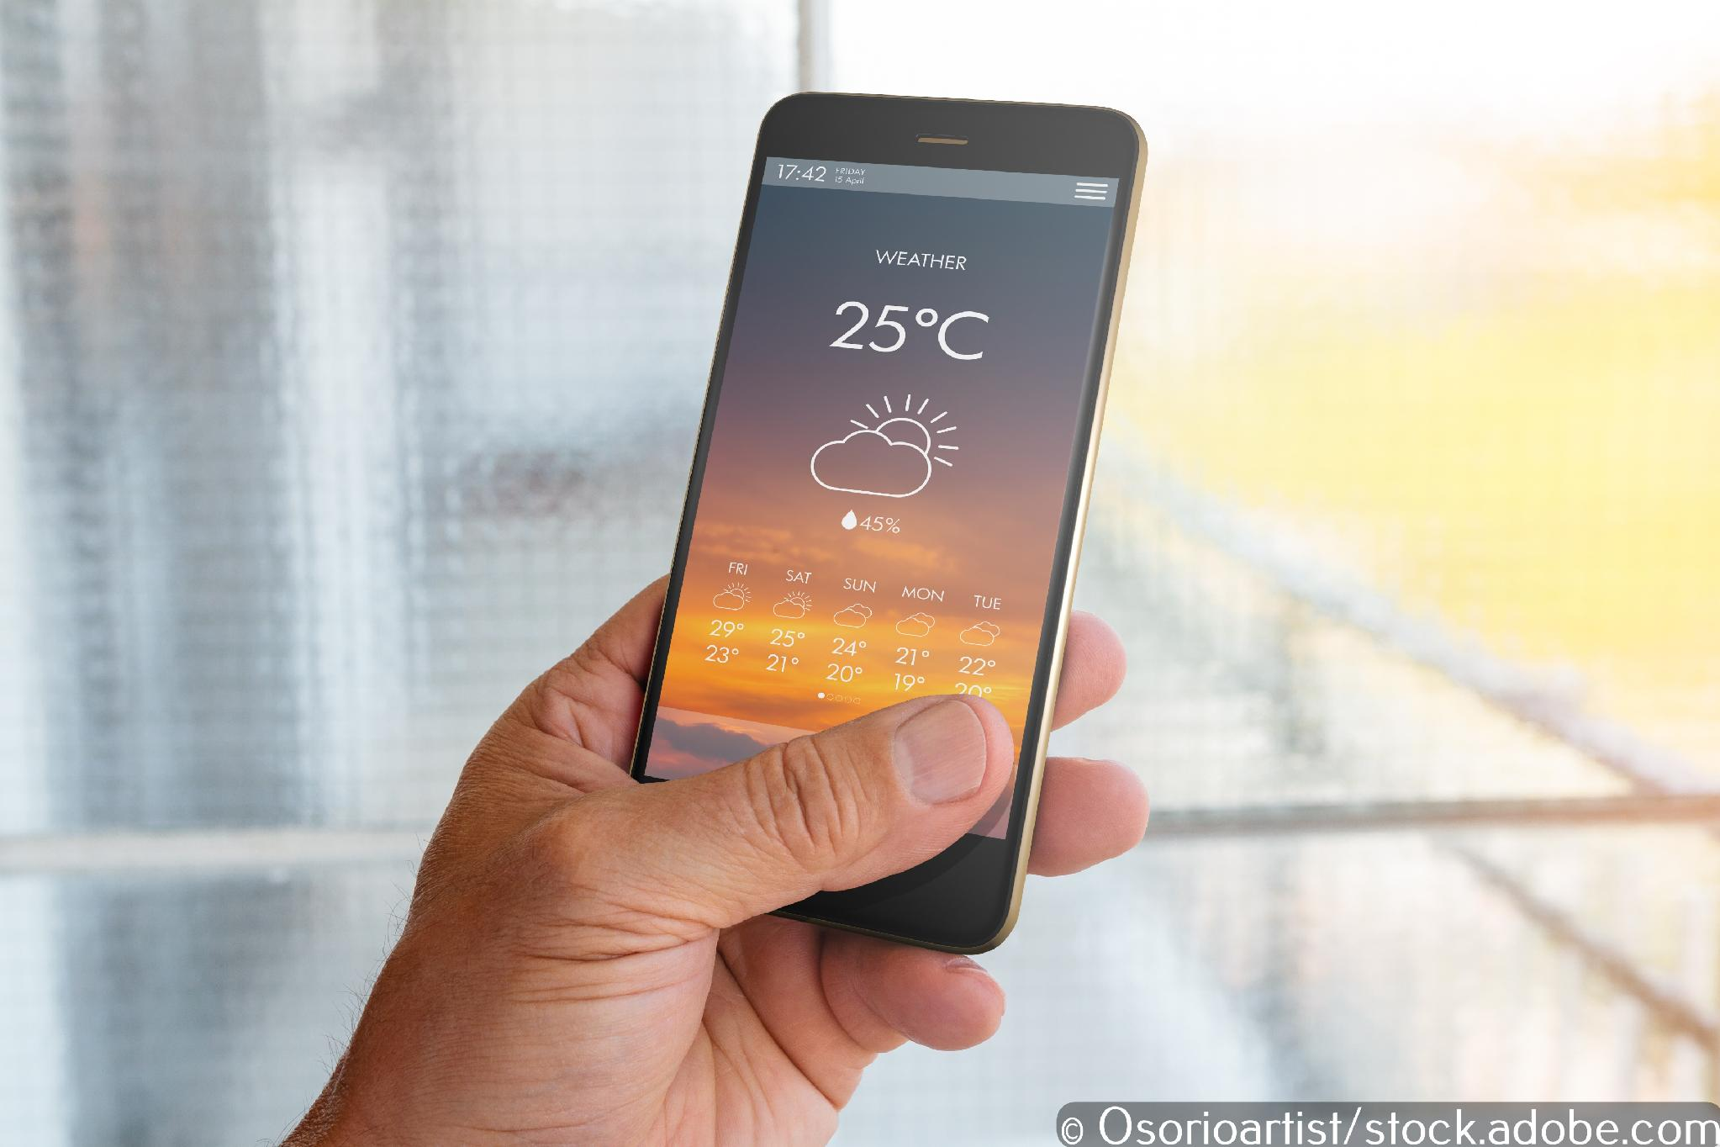
Modelling

Slide 4
Modelling
Modelling allows us to predict what is likely to happen when something changes, for example, working out how much profit will be made if prices change.
Spreadsheets are excellent for modelling because it is easy to set them up and perform calculations on data. It is also possible to try out lots of different scenarios to find the best result.

Slide 5

Uses of modelling
Modelling is used for many different purposes, including:
weather forecasting
financial decision making, including budgeting
science:
  epidemiology
engineering:
  bridge design
  rollercoaster design.

Slide 6
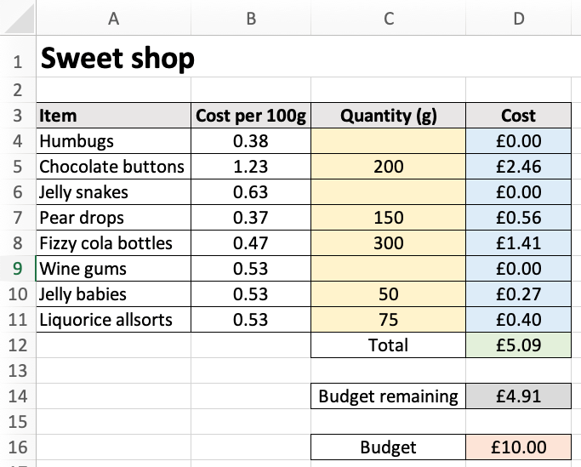
Sweet shop
This spreadsheet allows us to set a budget and then model how we can best spend the money to buy a wide range of different sweets.
Now watch video 5.1

Slide 7

Activity 5.1: Sweet shop

Slide 8
Goal Seek
Goal Seek is a spreadsheet tool that allows you to see how changing one value in a formula affects another.
It enables you to ask what-if questions to achieve a specific goal, for example, you can use it to find out the price you need to sell an item for in order to make a certain amount of profit.
Now watch video 5.2

Slide 9
Activity 5.2: Cupcake challenge

